Slide 1
What does home-schooling mean?
If you're new to the idea of homeschooling, you may picture it as:
children sitting at desks or around the kitchen table
textbooks and workbooks open in front of them
Mom standing at the blackboard (or whiteboard) on the wall
everybody working from 9 in the morning until 3 in the afternoon.

Slide 2

Homeschooling or home school (also called home education or home learning) is the education of children at home, typically by parents but sometimes by tutors, rather than in a formal setting of public or private school.

Slide 3
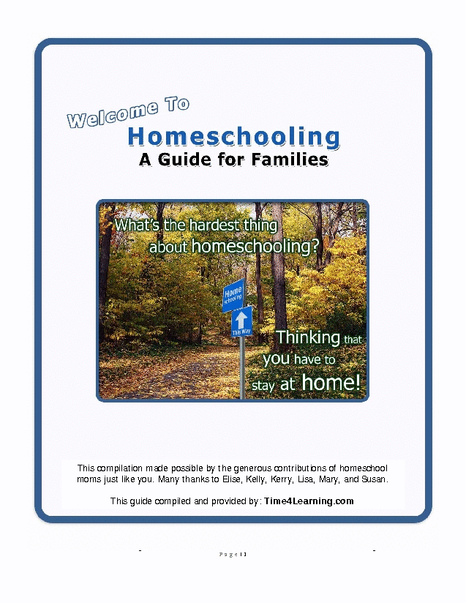
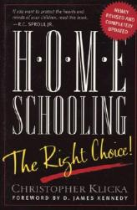
It is also an alternative for families living in isolated rural locations or living temporarily abroad.

Slide 4

Home schooling may also refer to instruction in the home under the supervision of correspondence schools.

Slide 5

1.better academic test results, 2.poor public school environment, 3.improved character/morality development, 4.objections to what is taught locally in public school.
Why do parents choose home-schooling?

Slide 6
How does school education differ from home-schooling?
what they learn,
how they learn,
where they learn.
What do you think?
Homeschooling is more flexible, effective and relaxing.

Slide 7
1. Families can seek out the best resources.
Homeschoolers are free to use other kinds of learning tools. And they can take advantage of the newest information and equipment at home, in museums and libraries, and in enrichment classes and at local colleges.
2. Testing is not the final goal.
Homeschoolers are free to explore and to demonstrate their mastery in multiple ways.
3. Parents can set standards for each child.
Schools must serve the whole population. As a result, teachers often aim at achievers in the middle. Homeschooling lets you take each individual child's ability into account, and set goals accordingly. Bright kids are challenged, and slower kids are not left behind.

Slide 8
4. Learning can incorporate the arts and sciences.
In public schools today reading and math are crowding out all the other kinds of learning. Things like making art or doing and hands-on science experiments are included as an afterthought, if at all. Homeschoolers can spend more time on art, science and any other subject they feel is important to them and to their children,
5. Lessons can go off-course.
When schools have a curriculum to follow -- and especially when high-stakes tests are involved -- Homeschooling lets you decide what to cover and when, and change it when it makes sense.

Slide 9


Home schooling yields positive academic, social, emotional, and spiritual benefits for any family that is willing and prepared to give it a chance.
The advantages of home-schooling

Slide 10

children that are home schooled outrank their public and private schooled peers in every academic area.

Slide 11

The advantages of home-schooling
Child safety has been cited by many parents as a motivation for home schooling.

Slide 12


There is also the benefit of reducing your child’s exposure to peer pressure regarding drugs, alcohol, and sexual activity.

Slide 13
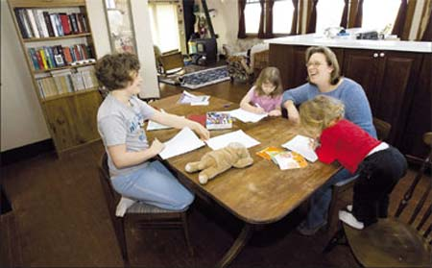
Bringing families closer together, as children really tend to thrive under parental attention. It has been said that a family that learns together, grows together!

Slide 14

Home schooling also has the added benefit of allowing parents to truly know and understand their children.

Slide 15

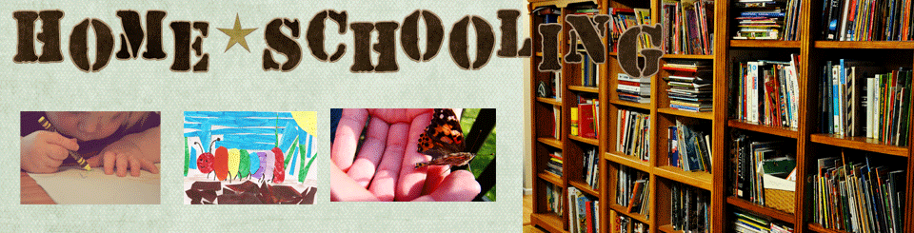
Even though money is not the main thing that should be considered in this circumstance, it certainly is one that should not be left out entirely.

Slide 16

The disadvantages of home-schooling

Slide 17


Lack of socialization. It certainly is true that the child will have less interaction with their peers than those who attend public school on a regular basis.

Slide 18

Children may feel left out or not able to rise above the level of academic achievement of their parents.

Slide 19

One more disadvantage of home schooling is that not every father or mother is a good teacher.

Slide 20

It may be difficult to foster in home-schoolers a sense of cooperation or teamwork.

